Slide 1

Mobile Optical Pluggable Alliance

Slide 2
OFC2026 March 18th: MOPA
Mark T. Watts
Associate Fellow
Verizon

Slide 3
MOPA Presents Capitalizing on Optics in 5G, 6G and Cloud RAN with Higher Data Rates and Longer Reaches
Leveraging optical technologies in RAN systems
Mark T. Watts
Associate Fellow
Verizon

Slide 4
Radio Access Network Pluggables & Future Demands
3GPP and O-RAN Generic Role Split
    3GPP: RAN, Core, User Equipment
    O-RAN: Open Fronthaul, Service Management & Orchestration, RAN Intelligent Controller, Transport
5G continuation & 6G Trends
    Simplification: 5G Core + 6G Core, Elimination of unused features
    Automation: Build upon today’s progress
    O-Cloud
    AI
    Energy Savings
    ISAC Integrated Sensing and Communication
    Continuation of 5G, 5G-A Use cases
          URLLC, RedCap & mMTC
ORAN Open Source to Linux Foundation
    Software Development
3GPP + Workshop for 6G: Management and Orchestration Alignment
O-RAN Alliance WG9: Transport Network Inclusions

Slide 5
Significance of Pluggable Specifications for RAN & Open Cloud for Operators & Impact of O-RAN
O-Cloud deployments have become table stakes for many providers
O-RAN Alliance (among many) key drivers of O-Cloud
RAN and Core deployments O-Cloud are become the norm not the exception
oCloud drives unique optics considerations
MOPA ties Optics Specification/standards importance can be amplified in an O-Cloud Based RAN access network for the following:
Supply Chain & Costs= Similar requirements from MOPA Operator Board
Network Management= FM, CM, PM = ORAN Alliance and OIF
Evolution= Leverage correct expertise during spec development of next generation of wireless networks
Timing/Synchronization Stability= Tie to ITU and IEEE

Slide 6
5G Core Impact and Network Health
User Plane Function (UPF)
Highly impacted
    >100G
    Downlink streaming
    FWA
    Both N3 and N6 Interfaces
Managing Network Health critical to customer satisfaction
    Optics in Radios are difficult to swap
    Power and Heat must be considered
    Reliability- Radios and oDU
    Network Management, FM, CM, PM

Slide 7




Significance of Pluggable Specifications for RAN & Open Cloud for Operators & Impact of O-RAN
Path to software enabled telco features
  Bandwidth solves a lot of problems
  QoS backup
  Necessary for Fronthaul Stability
    C-RAN or D-RAN configurations
Bandwidth Flexibility
  Centimeter Wave
  100MHz’s additional spectrum
    If available
Applications
  Slicing
  Private Networks
  5G/6G Core, oDU, oCU and O-RAN
Home
Small business
Applications
Mobility

Slide 8
Significance of Pluggable Specifications for RAN & Open Cloud for Operators & Impact of O-RAN
Path to software enabled telco features
  Nimbleness of Connectivity
  Automation
Assurance/Testing
  Hardware
  Software
  Activation Process
  Monitoring
  Interoperability
Applications
  Slicing
  Private Networks
  5G/6G Core, oDU, oCU and O-RAN
Home
Small business
oDU
Mobility
oCU
UPF

Slide 9
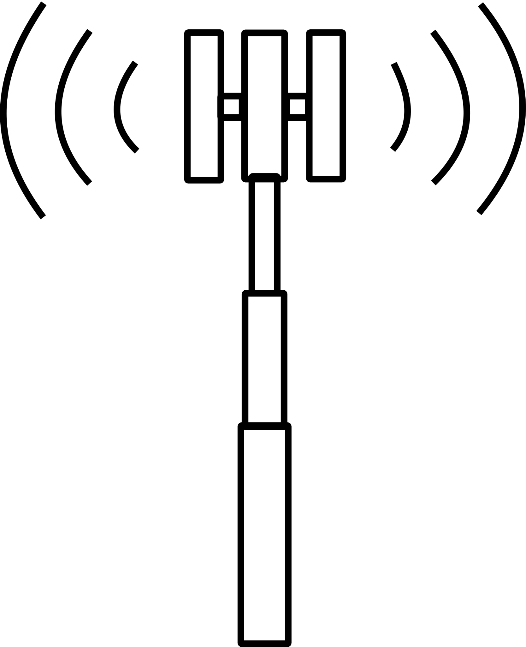

AI for RAN
AI for RAN:
Improving performance
Spectrum Coordination
Massive amount of data (potentially)
Power savings
Failure Event predictions
Signal Strength Estimations and Predictions (CSI)
Adapting Coding and Modulation schemes
oRU
Training
Inference
Data Center
oDU
oCU
UPF
AI
AI
Latency Sensitive
Fiber
Data Center Backup Data Lake
Fiber based services

