Slide 1
MOPA(I)
Antonio Tartaglia

Slide 2

Who let the droids out ?

Slide 3


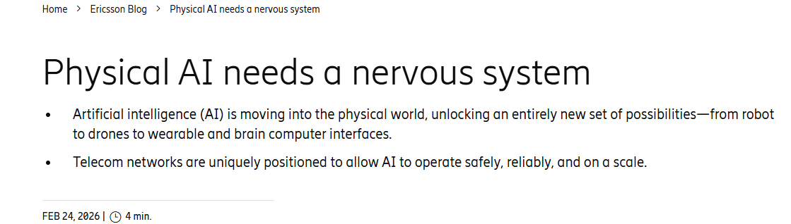

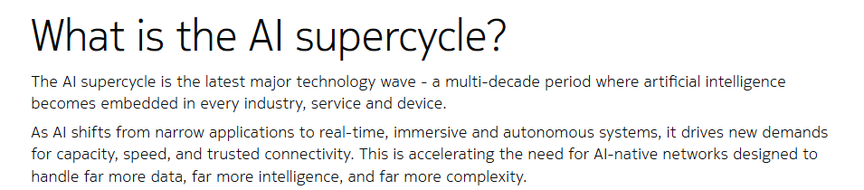

Mobile access will write the next page of the AI story
… but how ?

Slide 4

The fundamental things apply, as time goes by
“Plug it again, Sam”

Slide 5
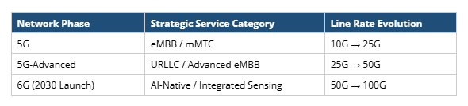
Easy predictions
Faster optics will be needed
The growth rate goes up and down, but mobile traffic continues to grow
High temperature operation will remain important
Moving extra power at high case temperature, whenever possible
Minimal impact on Precision Time Protocol (PTP) accuracy will remain important
Designing devices with latency determinism in mind
Uncompromised EMI/EMC performance will remain important
Design of RAN systems may have to come to terms with optical transceivers physics
High bit rate, long distance, low power: pick two…
5

Slide 6
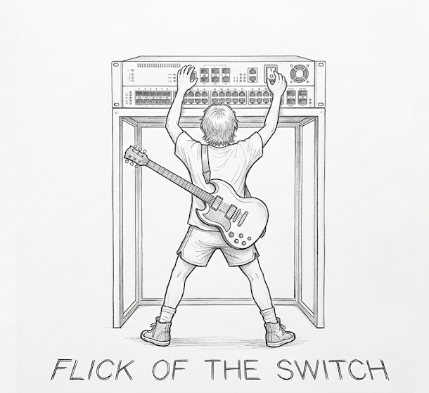

Flick of the switch/router

Slide 7
Reasonable prediction: packet switching will help a lot
Backhaul
SFP sized optics
May use larger form factors
DU
Pkt
DU
Pkt
CO
Pkt
Cell site #1
Cell site #N (typ. 4.8)
Cloud RAN
RU
Pkt
“Packet switched”
Pkt
vDU
Pkt
RU
“Semi-passive WDM”
Pkt
vDU
Pkt
RU
“Passive WDM + Packet”
Pkt
Backhaul
S1, N3
LLS CRAN
DU + CU
RU
Pkt
“Packet switched”
Pkt
Pkt
RU
Pkt
“Packet+ WDM”
Pkt
RU
“Passive WDM”
RU
Direct fiber
CRAN hub site

Slide 8
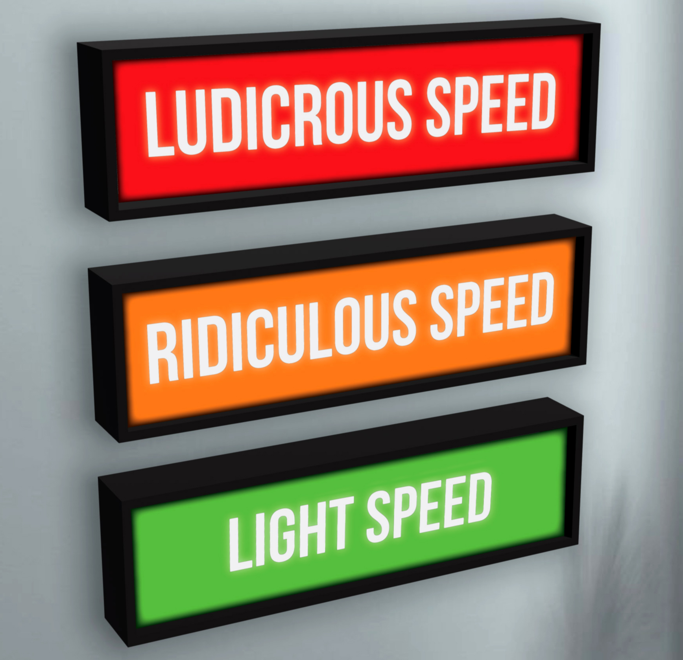
Ludicrous speed ?

Slide 9
Not so obvious prediction: the path beyond 100G
“Ludicrous speeds”, the day they will be used in RAN transport is closer than it looks
Important to define datacom optics with an eye to future reuse in telecom/RAN, MOPA’s here to help
Adapting emerging technologies from scale-out (rack to rack) AI networking for DRAN blueprints
High capacity, short distance (up to 2km), lower power consumption
Highly reliable, low latency, sync friendly
Do we still need to push for SFP-sized optics ?
Or should we push for SFP-sized copper/LPO, and add switches to host OSFP/QSFP sized optics ?
Adapting emerging technologies from scale-across (DCI) AI networking for CRAN blueprints
High capacity, long distance (up to 40km) , higher power consumption
No obvious path to SFP size so far → will need switches
Performance vs. cost optimization, simplification
Coherent lite, quasi-coherent ?
….what if Hollow Core Fiber gets deployed ?
PAM-4 revival for long distance
Redefinition of “long distance”, that in RAN is latency limited

Slide 10
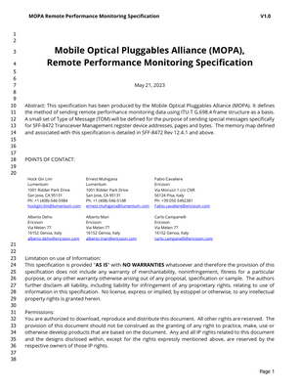
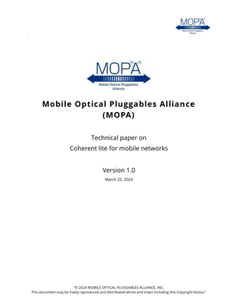
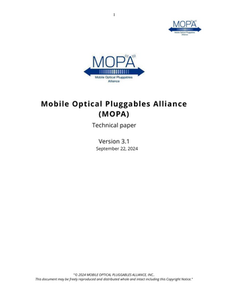
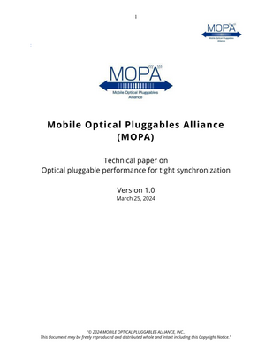
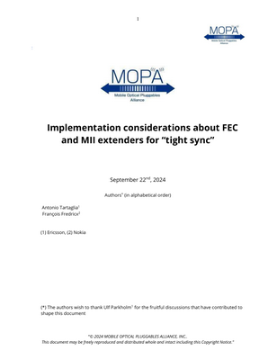

Rearchitecting of the MOPA main technical paper (March 2026)
Remote Performance Monitoring specification
Sending SFF-8472 Transceiver Management info over G.698.4 frame structure
Technical Paper on Coherent Lite
Tests of single laser coherent bidi transmission based on circulators
ITU-T SG15 Q6
MOPA Papers 26a:
MO: Market Outlook
RBP: Requirements and Blueprints
NT: New Technologies (incl. operational methods)
OIF
d
ITU-T SG15 Q13
Technical Papers on tight Synchronization
Parameters for characterized internal latencies
Pluggable classes for latency variations
Implementation considerations
IEEE 802.3
SNIA, OIF
← all MOPA technical publications are publicly available here

Slide 11
Progress made in the last working cycles
3.2
3.3
26a
Apr 2025 OFC 2025 | Oct 2025 ECOC 2025 | Mar 2026 OFC 2026
Tight Sync: SNIA SFF 8472 has included MOPA’s pluggable latency parameters, First presentation of the topic to OIF CMIS
Optical Auto Negotiation (OAN): Demo given in ECOC 2025. Working towards MOPA specification.
50G DWDM standardization: common contribution of MOPA members to ITU-T SG15/Q6
Power consumption methodology: measurement of 25G DWDM module power, considerations on power consumption dependence on operating case temperature
Coverage of emerging technologies : Hollow Core Fiber , XR optics, Quasi-coherent optics, LPO monitoring continues in the background

