Slide 1
OFC 2026 Workshop March 15, 2026
”How to Make More Money Out of Optics for Fixed and Wireless Access Networks?”
Evolution of Optical Solutions to Support Radio Access Networks:
An Industry Perspective
or
Why should the optics industry care about making products for mobile networks?
Stefan Dahlfort, PhD
President, MOPA
Ericsson

Slide 2
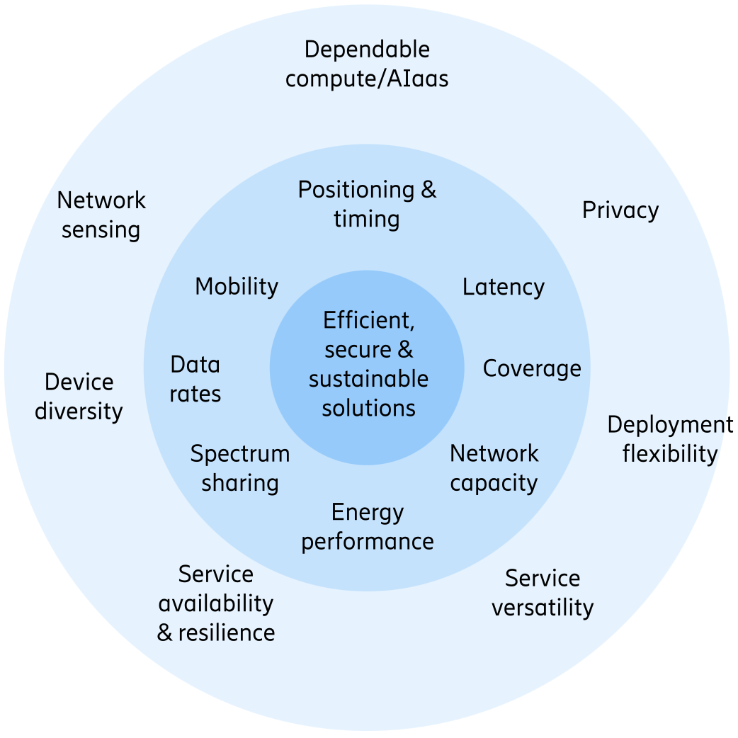
6G is coming…
End of 2023, ITU released the 6G vision document IMT-2030
Evolving 5G’s mobile broadband (MBB) and fixed wireless access (FWA)
  More spectrum, higher data rates
  Lower latency
  Improved energy efficiency
  Indoor networks, and billions of devices…
New capabilities
  AI for networks – Highly performing, automated and
  programmable networks
  Networks for AI – Enabling powerful AI applications
Trial and pre-commercial systems ~2028-2029
Commercial 6G networks ~2030
  6G service at OFC 2030 in San Diego?

Slide 3
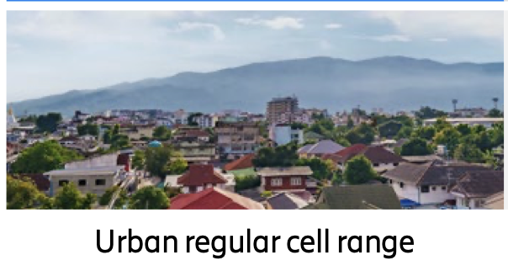
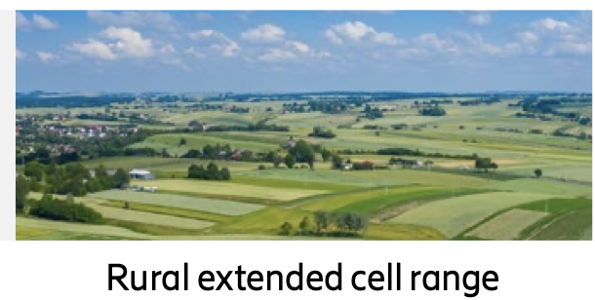
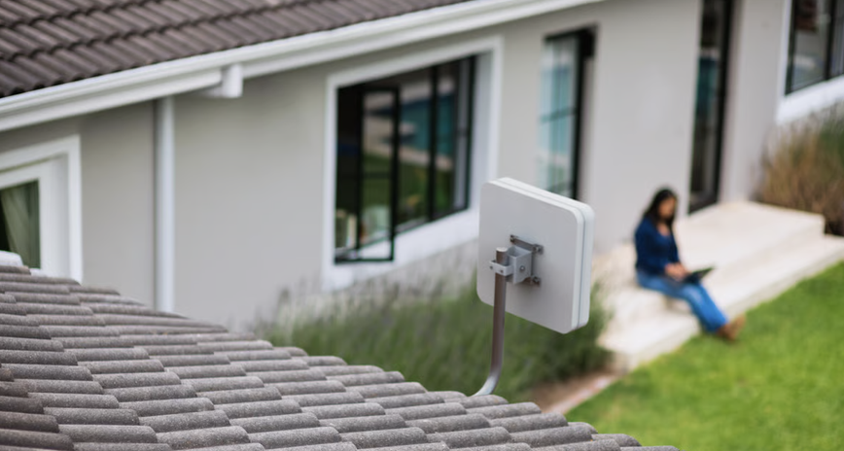
Fixed Wireless Access
FWA is using mobile networks technologies for fixed broadband applications, eg mmW ~28 GHz
Peak data rates – 100s Mbps towards Gbps
Vey cost-effective installation compared with fixed broadband (cable, fiber)
Especially beneficial for unconnected homes or replacing low performing xDSL or costly cable
Fastest (?) growing broadband access technology
  185M subs 2025 to 350M subs 2031: +90% in 6 years
    (Source: Ericsson Mobility Report)
Using same type of optical modules as mobile networks Higher volumes

Slide 4





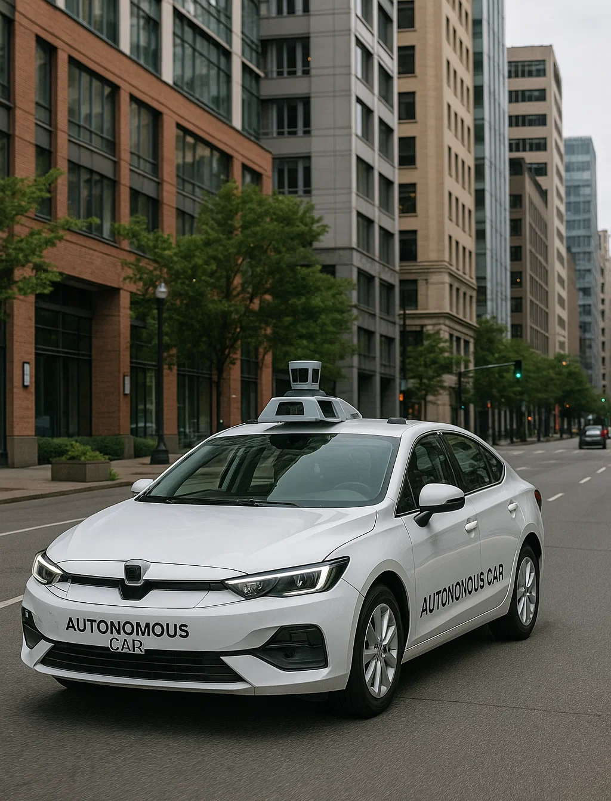

New world: AI-native use cases
AI‑Native Devices Increasing
AI‑enhanced smartphones
AI/AR glasses
Laptops
Autonomous vehicles & droids
AI‑enabled surveillance & sensing devices
Examples of New AI‑Driven Use‑Cases (driving traffic growth)
Real‑time AI assistants
AR “see‑what‑I‑see” sharing
Immersive AI‑assisted gaming
AI companions
Video‑AI analytics
What’s Driving Traffic Growth
Cloud‑based perception & inference:
AI agents and assistants requiring video processing offloaded from device to the cloud
Uplink‑heavy workloads

Slide 5






Uplink traffic growth with GenAI applications
%
AI Smartphone app
AI/AR glasses
AI cloud gaming
AI companions
AI cameras
Device density per km²
Subscriber penetration
Moderate
Medium
High
Uplink (UL) traffic growth from a range of different GenAI applications: Medium scenario: 3x
Impact on fronthaul optical data rates?
                User traffic is very DL heavy, but coding is much heavier in the UL,
                leading to total user + control traffic being roughly symmetrical
                Optical module data rate need to scale accordingly, i.e. 3x

Slide 6
MOPA in a shifting landscape
Very high-volume AI/data center deployments is shifting optical module R&D efforts
Challenging for telecom/outdoor/mobile networks to source optical modules
To help component and module vendors to motivate R&D efforts in mobile optics, MOPA will provide clearer timing for new optical modules
  Adding When to the Whys and Whats regarding mobile network optical modules
Introducing MOPA Blueprint outlooks
  Using gating factors, like WRC radio regulations and 3GPP specification releases

Slide 7
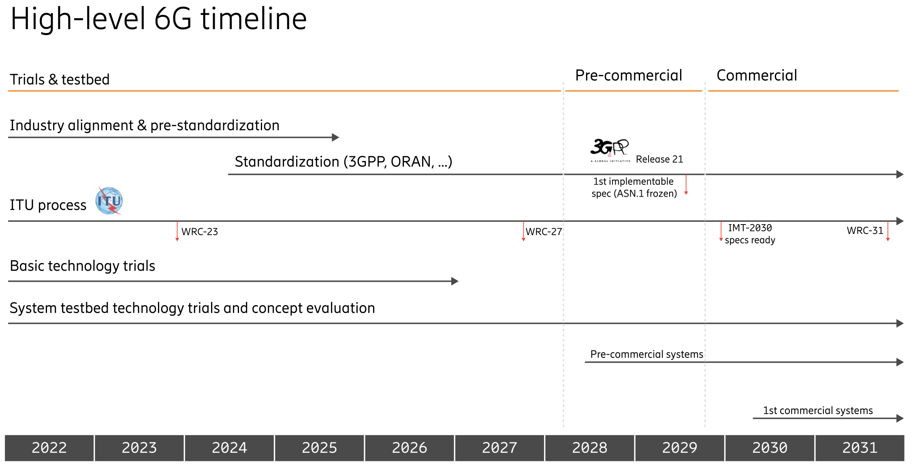

MOPA Blueprint outlook example
MOPA Ver. 1.1 (OFC)
- SFP56 FR, LR, BR15
MOPA Ver 3.0 (OFC)
- SFP+/SFP28 LWDM 15 km
MOPA Ver. 28a (OFC)
- SFP112 FR, LR, BR
MOPA Ver. 29a (ECOC)
- SFP112 xWDM

Slide 8
MOPA Blueprint outlook example
                SFP112 for system tests
                is needed now!
MOPA Ver. 1.1 (OFC)
- SFP56 FR, LR, BR15
MOPA Ver 3.0 (OFC)
- SFP+/SFP28 LWDM 15 km
MOPA Ver. 28a (OFC)
- SFP112 FR, LR, BR
MOPA Ver. 29a (ECOC)
- SFP112 xWDM

Slide 9

