Slide 1

Open Cloud + 6G April 2025

Slide 2
6G, O-RAN and Open Cloud
3GPP and O-RAN Generic Role Split
3GPP: RAN, Core, User Equipment
O-RAN: Open Fronthaul, Service Management & Orchestration, RAN Intelligent Controller
6G Trends
Simplification: 5G Core + 6G Core, Elimination of unused features
Automation: Build upon today’s progress
O-Cloud
AI
Energy Savings
ISAC Integrated Sensing and Communication
Continuation of 5G, 5G-A Use cases
URLLC, RedCap & mMTC
3GPP Workshop for 6G: Feb 2025
3GPP and O-RAN Alliance Workshop: April 2025

Slide 3
Significance of Pluggable Specifications for RAN & Open Cloud for Operators & Impact of O-RAN
O-Cloud deployments have become table stakes for many providers
O-RAN Alliance (among many) key drivers of O-Cloud
RAN and Core deployments are become the norm not the exception
oCloud drives unique optics considerations
Optics Specification/standards importance can be amplified in an O-Cloud Based RAN access network for the following:
Supply Chain & Costs
Reliability- Radios v. oDU
Network Management, FM, CM, PM
Expectations
Leverage correct expertise during spec development
Timing/Synchronization Stability

Slide 4




Significance of Pluggable Specifications for RAN & Open Cloud for Operators & Impact of O-RAN
Path to software enabled telco features
Nimbleness of Software
Automation
Assurance/Testing
Hardware
Software
Activation Process
Monitoring
Interoperability
Applications
Slicing
Private Networks
5G/6G Core, oDU, oCU and O-RAN
Home
Small business
Applications
Mobility

Slide 5
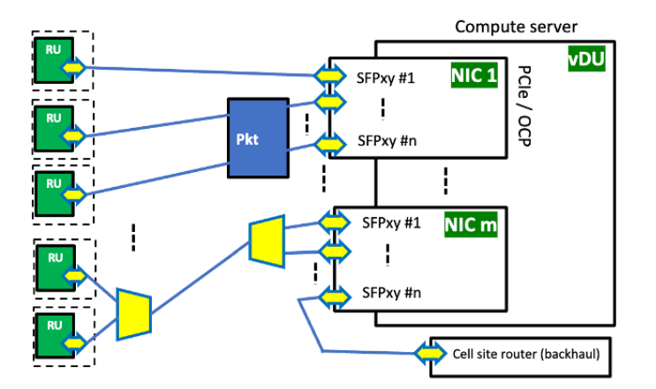
MOPA & O-RAN Cloud RAN Optics
This area is introduced with a high-level description and summarized responses from a MOPA Operator Advisory Board questionnaire.
The results point to strong operator interest for a range of blueprints including both DRAN and CRAN, with bidi, DWDM and packet aggregation technologies.
Another result indicates that the data rate outlook is relatively short term.
ORAN Cloud RAN Optics
Specification interest is ramping up in Working Group 6 oCloud & WG9
WG9 and WG6 committed to work to create specifications
Measurements, Alerts, PM, FM, CM likely will wrap into Transport Inclusion

