Slide 1
OFC 2025
Initiatives for Facilitating “Tight sync”
François Fredricx, Nokia Antonio Tartaglia, Ericsson

Slide 2


What is “tight” synchronization, why do we need it?
Distribution of sync via network (PTP)
Network-wide sync of all RUs (air interfaces)
TAE between any 2 RUs => TE between any RU and PRTC
mMIMO across cluster of RUs (fronthaul)
TAE between any 2 RUs in cluster => TE between any RU and common clock reference
Different Categories of accuracy
Localisation accuracy
Very accurate => only for local PtP links
Classification of intermediate nodes (T-BC)
Max cTE and dTE and total TE per Class A / B / C / (D) node (ITU-T G.8273.2)
=> TE per RU-PRTC
RU
T-BCs
DU
RU
T-BCs
CU
T-BCs
TAE network-wide
RU
T-BCs
DU
Mobile Core
T-GM
TAE RU cluster
RU
=> TE per RU-DU

Slide 3
Role of pluggable modules for tight sync
Synchronization distribution via PTP assumes symmetrical latency in both directions. Known asymmetries can be compensated for.
Mobile fronthaul poses highly demanding requirements in terms of end-end synchronization accuracy between T-GM and RUs
Contribution of the pluggables to latency (a)symmetry and hence to cTE can no longer be neglected
MOPA proposals;
Allow pluggables to be characterized for their typical Tx and Rx latencies so that these can be taken into account by the host Sync Client (see next slide) => How can they be measured, which info to store in module (EEPROM)
Allow pluggables to be classified in terms of inaccuracies on their Tx and Rx latencies so that their consumption of the end-end cTE budget can be estimated. => Definition of classes, which info to store in module (EEPROM)

Slide 4

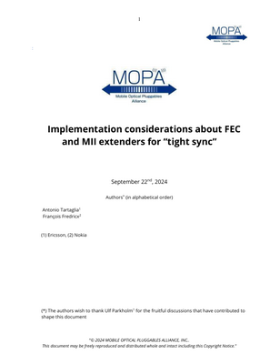
Initatives by MOPA members
Proposed Data structure for pluggable’s Tx and Rx static latencies (averages) Proposed latency classes for pluggable’s Tx and Rx latency uncertainty (deltas)
ITU-T SG15 Q13 Appendix in G.8273.2
SFP (single lane) SNIA SFF 8472: Update of Timing data structure
QSFP (multi-lane modules) OIF: similar update of latency data structure
MOPA Technical Papers on Tight Sync
Implementation considerations; avoiding sync inaccuracies when MII extensions and/or segmented FEC
IEEE 802.3
802.3dj: Raising awareness to avoid inaccuracies
[TBD] feedback on alignment marker position when no GMP channel

Slide 5
Summary
Tight Syncronization is relevant for 5G/6G network and application use cases
Helping the design of nodes and of networks by characterization of pluggables
MOPA has on-going initiatives to bring this in relevant Standard organizations
Next step: multi-lane pluggables

Slide 6
Copyright © 2023

