Slide 1
Optics for Cloud RAN
ECOC2024 WS14, “Mobile Optics for 6G and Open Cloud RAN: New Concepts or More of the Same?”
Antonio Tartaglia

Slide 2
Cloud RAN optical solutions
Compute server
RU
Packet
Switch
vDU
NIC 1
PCIe
RU
NIC m
RU
Cell site router (backhaul)

Slide 3
Insights from the MOPA Operator Advisory Board: plans
Some operators are already using Cloud RAN
Most are currently performing lab evaluations, planned introduction 2026+.
Feature parity of Cloud RAN and integrated RAN difficult to achieve
Some operators plan/investigate to use packet switching between RUs and vDU
Others prefer passive WDM.
Some plan/will investigate optical switching, for dynamic path reconfiguration
Cloud RAN could be used in both Distributed and Centralized architectures
All operators indicated that they plan to mix vDU and RU vendors
Either already from the start or in later stages.

Slide 4
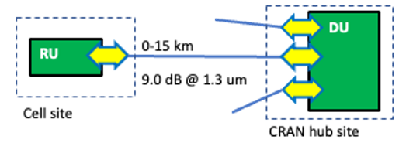
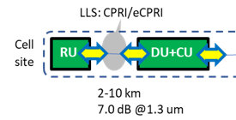
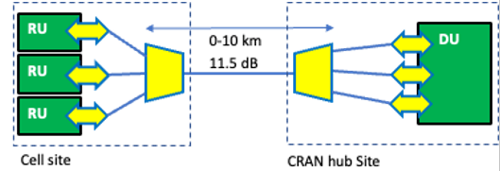
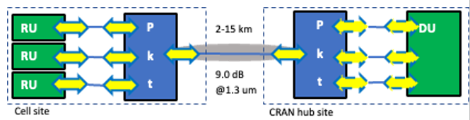
Insights from the MOPA Operator Advisory Board: preferred optical blueprints
Popular blueprints in integrated RAN will also be popular for Cloud RAN
· 7.2.1 (DRAN) and 8.2.1 (CRAN) gray parallel fibers
· 8.2.3 and 8.2.2. passive DWDM and CWDM CRAN
· 8.2.7 packet switching for CRAN
Data rates and form factors
Common indication of SFP28 ports for LLS connections
Some will also use SFP+ and are looking to SFP56 for the future.
100G/QSFP28 may also be used for aggregation (packet and port) and for future higher data rates
Point of attention: not all servers are created with SFPx…
Requirements on optical pluggables:
No discounts: the same optical requirements for integrated RAN are a must for Cloud RAN
Inter-operability is critical to success
Power consumption and heat are critical

Slide 5


Integrated RAN vs. Cloud RAN: optical connectivity challenges
SFPx
SFPx
DU
Telecom fiber plant and site infrastructure
RU
Pluggable
Pluggable
Telco
Compute
Compute server
?
Telecom fiber plant and site infrastructure
SFPx
RU
vDU
NIC
Pluggable
Pluggable
IT infrastructure
Typical refresh cycle: 3 years
Variety of servers, NIC cards, optics…
IT typical tools to manage features of pluggables
Telco infrastructure
Typical lifetime : 10-15 years
Telco typical tools to manage features of pluggables
CLI, LCT/GUI, NMS, SDN controllers, …
CLI
sudo ethtool –m port1
NC-SI

Slide 6
Adaptation needed between the two domains
Compute
Telco
Compute server
?
SFPx
Telecom fiber plant and site infrastructure
RU
vDU
NIC
Adapter
Pluggable
Pluggable

Slide 7
SFPx based NICs
Compute server
SFPx
SFPx
Telecom fiber plant and site infrastructure
RU
vDU
NIC
Pluggable
Pluggable
SFPx in NICs must be specified to inter-operate with SFPx in RU’s

Slide 8
QSFPx based NICs
SFPx *R
RU
Pluggable
Pluggable
Compute server
SFPx *R
RU
QSFPx *R4
Pluggable
vDU
NIC
Breakout
Telecom fiber plant and site infrastructure
Pluggable
Pluggable
SFPx *R
RU
Pluggable
Pluggable
QSFPx in NIC must be specified to support per-lane interoperability with SFPx in RU’s
Parallel fiber standards like SR4, DR4, DR4+ 🡪 simple fiber unbundling breakout,wavelength generic remote SFPx
Parallel wavelength standards like FR4, LR4 🡪 “filtered” breakout, remote SFPx of matching wavelengths
SFPx *R
RU
Pluggable
Pluggable

Slide 9
Packet-switch based telco infrastructure
Compute
Telco
Compute server
SFPx
SFPx
vDU
NIC
Packet Switch
Telecom fiber plant and site infrastructure
RU
Pluggable
Pluggable
DAC / AOC
Pluggable
Pluggable
Variety of form factors
Direct attach copper cable (DAC) or Active Optical Cable (AOC)
Completely decoupling the IT and telco worlds by using a packet FH switch
Telco infra designed to last for 10-15 years
Modular switch design (server facing ports, fabric, fiber facing ports) to adapt to faster cycles of servers Low-cost short reach DAC/AOC to connect servers to the switch

Slide 10
Comparison at a glance
Pro’s
SFPx form factor is perceived in the industry as the choice for RAN, easier to get SFPx with feature parity of those in RU’s
Easier to support passive WDM
No additional boxes on site
No additional boxes on site
Full flexibility and future proofing of the telco infrastructure
Support of a variety of connectivity solutions on the fiber side
Freedom to innovate on the server side
Con’s
Power profile of complex SFPx (longer reach, WDM) could exceed the limits of supported by the NIC
Additional “breakout” patchcord needed
QSFPx form factor is NOT perceived in the industry as a form factor for RAN, getting feature parity with SFPx in RUs requires extra effort
Harder to go WDM if needed
Extra packet FH box is needed (site footprint/Tk)
SFPx in NIC
QSFPx + breakout
Packet FH

Slide 11
Copyright © 2022

