Slide 1


Optical Pluggables
for Next Generation Mobile Fronthaul
ECOC 2024 MOPA Workshop
2024.09.22
SK Telecom
Hongseok Shin
Notes:
안녕하십니까? SK브로드밴드 (사장) 이형희 입니다.
바쁘신 중에도 이렇게 자리해 주셔서 감사합니다.
SK브로드밴드 사장으로 취임 후 첫 인사를 드리게 되었습니다.
앞으로 잘 부탁 드린다는 말씀 먼저 드립니다.
오늘은 ‘유무선 미디어 플랫폼으로 도약’ 이라는 내용으로,
SK브로드밴드의 사업추진 방향에 대한 설명을 드리고자 합니다.

Slide 2
30/40km Fronthaul 25Gbps WDM
Currently, the longest WDM blueprints for CRAN in MOPA are 15 km
Mobile operators want the longer distance
Smaller number of BBU hotels to cover the same area
Saving the operational cost (renting the space, providing air-conditioning/UPS)
Mobile systems tend to support the longer fronthaul distance.
The round-trip delay is not 3GPP requirements anymore but implementation issue
One of 5G system vendors for SK Telecom supports 30 km fronthaul.
A mobile system vendor in Japan reported its vRAN system with 50 km fronthaul.
Recent MOPA technical report (version 3.0) mentioned ‘30-40 km LLS WDM solutions’.
Loss budget versus distance/wavelength band
Issues to be solved: Chromatic dispersion in C-band, higher fiber loss in O-band
12.5 GBd PAM4 is away from the interest due to the absence of PHY standards.

Slide 3
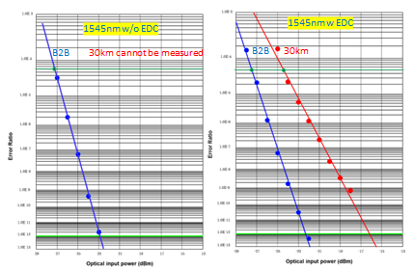
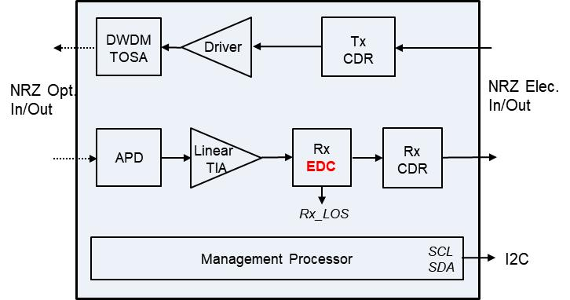
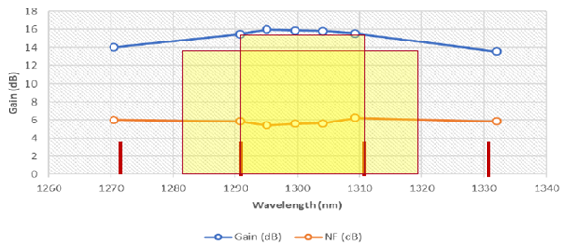
30/40km Fronthaul 25Gbps WDM
Electrical Dispersion Compensation in C-band
SK Telecom & OE Solution developed EDC integrated 25Gbps SFP28 (press released in Feb. 2023)
Power consumption less than 2.5 watt for I-temp version
Supports CRPI and eCPRI both (different clock rate)
Increasing Link Budget in O-band
Bismuth Doped Fiber Amplifier for WDM Optical Amplification
16dB gain, 60nm range with gain flatness of about 2dB

Slide 4
50Gbps Optical Pluggables
MOPA Technical paper describes 50Gbps 15km LLS blueprint in Annex A.
Optical PAM4 modulation in fiber side
Electrical PAM4 modulation also in host side to suppress the cost increase of PCB
Up to 15 km P2P link, 18 dB of link budget
No. of Wavelength : Gray Bi-Di for single fiber, Colored Duplex for WDM
Formfactor : SFP56 is preferred to get a compatibility with 25Gbps optical pluggables
Candidates of wavelength plan
A baseline scenario of 800GHz LWDM and an overlay/expansion upgrade scenario of 100GHz DWDM.
Recently SK Telecom suggested an additional wavelength plan: A baseline scenario of 20nm CWDM and an upgrade scenario of 0.8nm DWDM in O-band
Receiver sensitivity of 50Gbps PAM4 is higher than that of 25Gbps NRZ → smaller link budget.
Bismuth Doped Fiber Amplifier is a potential solution to resolve the link budget issue in O-band.

Slide 5
100Gbps Optical Pluggables
Option 1: 2km or less for intraoffice connection
100GBASE-FR4 with 4 lambda 25Gbps NRZ for duplex
What for BiDi ? – 8 lambda 25Gbps NRZ or 2 lambda 50Gbd PAM4 in ITU-T G.9806 and IEEE 802.3dk
Option 2: up to 40km
100GBASE-ER (50Gbd PAM4) in O-band for duplex and WDM
ITU-T G.9806 and IEEE 802.3dk for BiDi
Option 3: 100G DCO for 40km or longer
DWDM C-band with dispersion immunity
Bi-directional transmission over a single fiber: potential transmission limitations due to reflections
Power consumption: 2.5 W for 25Gbps, 3.0 W for 50Gbps, and 4 W seems good for 100Gbps
Latency according to digital signal processing: few 10s usec → few usec
Affordable price for access networks.

Slide 6
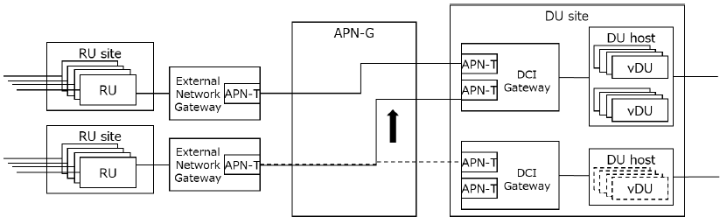
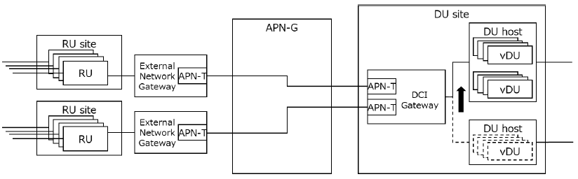
Dynamic Path Re-configuration in Fronthaul
IOWN GF expect Dynamic Path Re-configuration as one of 6G fronthaul features
Reduction of mobile system power consumption with elastic load balancing,
Network recovery against vDU failure
Optical switching-based method
The first candidate
Advantage on Energy consumption and deterministic QoS
Packet switching-based method
Alternative option due to the cost
Attractive if the meaningful aggregation ratio can be expected
Need to investigate the min/max/nominal traffic for e-CPRI

Slide 7


