Slide 1
Next Gen 100Gb/s Technologies for 6G Mobile Networks
KP Jackson
September 22, 2024
Notes:
Abstract: As more 5G spectrum is being unlocked and the number of live networks globally are well above 100, it’s critical to focus on the right optical solutions and the right time and cost for the evolving radio access networks and accompanying transport systems. This talk will outline the key requirements and some of the most important deployment use cases, called mobile optical blueprints, with the optical pluggables as the key building blocks. The case is made that this approach allows the industry to better focus its efforts.

Slide 2
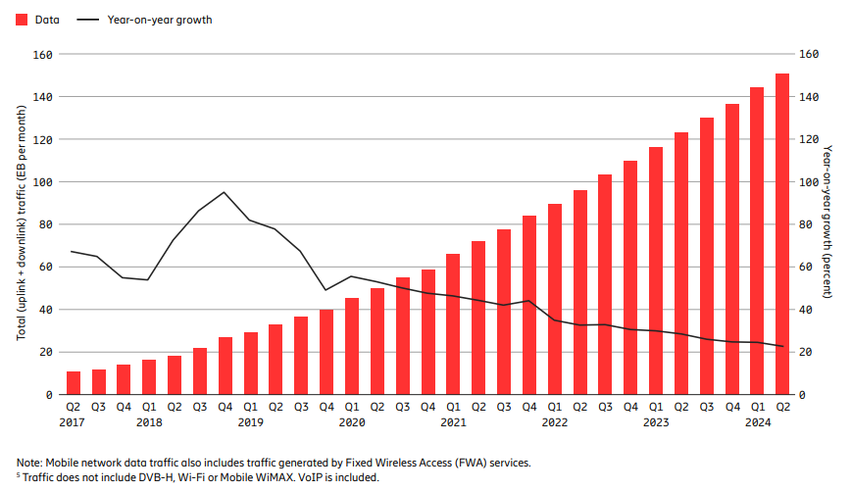
Motivation
Global mobile network data traffic
5G is expected to account for ~75% of mobile data traffic in 2029
Chipsets with generative AI capabilities, as well as phones that can process AI without connecting to a server have entered the market. These devices could shape new user behavior and change how apps and services are consumed in the future.
6G is expected in 2030. Given the ambitions of 6G, technology development must start now. It will place huge demands on the network, in particular, the LLS (fronthaul) portions.
25 & 50Gb/s (serial) are starting to be deployed. The follow-on data-rate is expected to be serial, SFP112, 100Gb/s.
25% YoY
Source: Ericsson Mobility Report Q2 2024 Update

Slide 3
Data-Center Optical Solutions
Historically, mobile network optical solutions have consisted of a plethora of different technologies and approaches.
In many instances this is due to an operator’s demographics, geography, & legacy operations.
Challenging for operators, system vendors and optical pluggable suppliers to focus on the most relevant device solutions.
➔ Ultimately may lead to higher-cost solution or a non-optimal solution.
To mitigate this, mobile network solutions should leverage high-volume data-center solutions/technologies wherever possible. MOPA organization can help with this.
However, mobile network environments have requirements that can be more challenging and therefore potentially increased costs.
Transceiver modules supporting multi-rate operation (Ethernet, CPRI)
Higher insertion loss budgets (Mobile network operators typically include margin for cable plant changes (damage, re-configuring, repairs, splicing, additional connectors, etc.))
Operating temp range (typically outdoor environments: -40C to +85C)
Low power dissipation, small, compact form-factors
Tight time-sync (latency)

Slide 4
Relevant Standards (to help drive focus and common view)
ITU-T G.9806 Amd 3 – 100Gb/s BiDi
  IL Classes: 15, 20, 23 & 25dB
IEEE 802.3dk Project -- Greater than 50Gb/s BiDi Optical Access PHYs
  Objectives: 10, 20 & 40km reaches (@100Gb/s)
  Corresponding IL Budgets: 6.3, 10 and 18dB
Other Relevant specifications
  ITU-T G.698.1/4
  IEEE 802.3cu – 400GBASE-LR4-6 (100Gb/s lanes)
  100G Lambda MSA – 100G-LR1-20 & 100G-ER1-30/40 (100Gb/s lane)
Goals
  Single wavelength / single lane (100Gb/s per lane) solutions for lowest cost, lowest power (?)
  Common technologies for all reaches (lowest cost, amortizing volumes)
  Legacy (lower data-rates) interoperability / co-existence desirable
Key Parameters
  Wavelength bands (upstream/downstream--over temp)
    Minimize CD penalties
    TEC likely required
  Link Budget
    Mobile network req’ts typically have higher IL Budgets (10km=7dB, 20km=11dB & 40km=20dB) which will result in higher launch powers, higher power dissipation.
  SFP112 form-factor (for LLS), 2.5Watt power envelope desirable
    Challenging for longer reach solutions (e.g. 40km), but larger form-factors (e.g. QSFP) may be ok (?)

Slide 5
xWDM Relevant Standards (& needs)
In many cases, LLS reside in fiber-starved environments---WDM can enable efficient use of fiber resources (ITU-T 9802.2)
Some mobile operators have identified the need for up to 30km reaches for fronthaul applications.
DWDM in C-band @100Gb/s (50Gbaud/lambda) can incur larger CD penalties for longer reaches.
Optical or electrical domain equalization likely be needed to overcome these penalties.
Prefer to use electronic means but power dissipation, size (density), latency and cost could be disadvantageous.
Analog EQ (vs. DSP) may be an option to minimize power dissipation.
O-band operation may have merit to minimize CD impairments (avoid Four-Wave Mixing penalties around fiber ZDW).
Ultimately may have different technology options depending on required reach.
  IM-DD for shorter reach => low-power cost-effective solutions
  “Coherent Lite” for longer reach => higher power dissipation and cost-performance solutions. (Can box manufacturers still utilize “one slot” for all technologies/reach solutions?)
Source: C. Cole, et al.

Slide 6
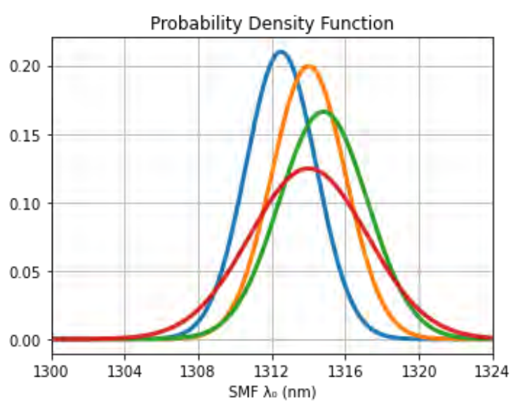
Update to Modern SMF Parameters for Calculating CD Penalties
ITU-T G.652 define ZDW (Zero Dispersion Wavelength) min/max = 1300/1324nm
ZDW lower and upper extremes are rarely encountered in many applications.
Longer fiber links are generally composed of several lengths of cable, each of which exhibits CD parameters that are uncorrelated with each other
Restricting transceiver design and manufacturing to use ZDW min/max is an unnecessary burden => increased power & costs.
Collaboration between ITU-T and IEEE 802.3.
  SG15 examined the statistical properties of chromatic dispersion (CD) for G.652 / G.657 fiber links.
  Revised Recommendation G.652 was initiated in the July 2024 meeting.
  Enables the use an improved statistical link design methodology
Fiber Mfg Distribution
➔ Fiber parameters are not changing, rather the way links are engineered using those parameters.

Slide 7
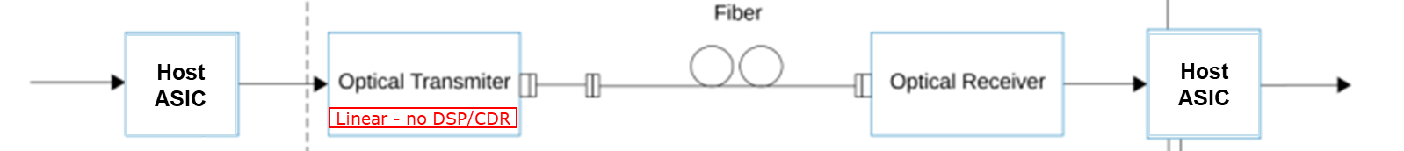


Emerging Technologies: Linear Pluggable Optics (LPO)
  Reduced power/cost by eliminating DSPs/CDRs in optical modules (~40% power savings)
  OIF project: CEI-112G-Linear-PAM4
  MSA to develop electrical and optical interoperability specifications (https://www.lpo-msa.org)
  100Gbps initially, extensions to 200Gbps

Slide 8
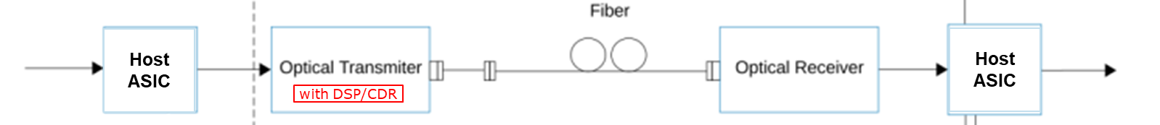
Emerging Technologies (con’t): RTLR (half-retimed or LRO)
  OIF Project.
  Provide end-users with some power savings (~50% of LPO) but at the same time the potential for interoperability with legacy fully retimed modules.
  Re-timers on the Tx path; Rx path linear (i.e. no DSP or CDR in the optical Rx path)
  NO change to the electrical and optical paths at the “front-end”, Tx side (retain IEEE TP1 and TP2 compliance test points).
  Modify TP3/TP4 test points to promote vendor interoperability with the linear receiver portion—leveraging the OIF-112G-Linear (LPO) project specification.
  100Gb/s data-rate specification
  Derivative project started for 200Gb/s RTLR.

Slide 9
100Gbps Survey
Survey sent out to the MOPA members in Summer 2024 to assess 100 Gbps technology and its availability. (“serial” 100Gbps/SFP112)
Availability of retimed implementations:
  EML: in general, 53 GBaud EMLs suitable for FR/LR/ER/BiDi are currently available at a component level.
  LR 10 km: One response indicated availability end of 2024, several indicate availability 2025/26, and one indicated after 2026. EML/PIN component technology is indicated.
  ER 40 km: One response indicated availability at the end of 2024, while several indicate availability after 2026. EML/APD or enhanced EML w/ PIN are indicated.
  BiDi: Several indicate availability 2025/26, and one indicates after 2026. EML/PIN is indicated.
  FR 2 km: One indicates after 2026. EML/PIN is indicated.
Availability of LPO and LRO SFP112 implementations: There were fewer responses compared with retimed. Some indicate LPO FR, LR and SR and LRO LR availability end of 2025.
SFP112 signal recovery / integrity features: Several indicate analog EQ but also DSP with enhanced equalization features is mentioned.
Power consumption:
  Retimed LR 10 km: Responses: several stated the ambition to reach the target of 2.5 W, but also 3.5 W and 2.4-3W are indicated.
  Retimed ER 40 km: 3.5 W, 2.4-3W and 3-3.5W are indicated.
  BiDi: same as dual fiber
  FR 2 km: 1.9-2.5W is indicated.
  LRO: 1.4-2W is indicated for LR/ER/BiDi.
  LPO: 1-1.5W is indicated for FR/LR.
Temperature range: all pluggable options are planned to be available in C-, E- and I-temp.
Multi-rate operation: In general, pluggables will support multi-rate operation, where lower data-rates may be supported with CDR bypass.
Enhanced features and management: The responses indicated that SFP112G CDR based pluggables will support BER test, electrical loopback, optical loopback capabilities, while this may not be supported on LPO/LRO modules. SFP112 with CDR will support tight-sync class C, while tight-sync support with LPO/LRO is not clear at this point. Regarding diagnostic features, supported functions mentioned were Tx/Rx SNR Monitor and Eye Monitor.

Slide 10
Summary
100Gbps technology solutions will be needed for next generation 5G & 6G mobile networks
  ➔ LLS (fronthaul) although applicable in all segments of the network
Leveraging high-volume data-center solutions will enable lower costs
  Utilize existing standards wherever possible
Much of the technology (e.g. optical components, ASICs, modules) is available today
  Market demand (applications, use-cases, etc., driving the need)
Some mobile network requirements may require customization which could result in increased costs.

Slide 11
Copyright © 2024

