Slide 1
OFC 2024 SHOW FLOOR PROGRAMS
Mobile Optics (MOPA) for the 6G Era
Advances in Coherent Lite for Mobile Networks
Tuesday, 26 March, 11:00 – 12:00
Speakers:
Fabio Cavaliere, Ericsson, Italy
Gert Sarlet, Coherent, United States
Acknowledgements:
Marco Di Stefano, Ericsson, Italy
Name, department name, etc.

Slide 2
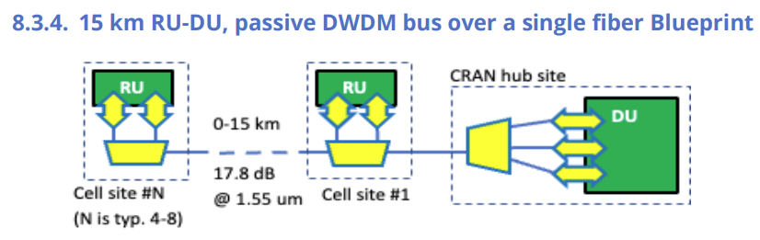
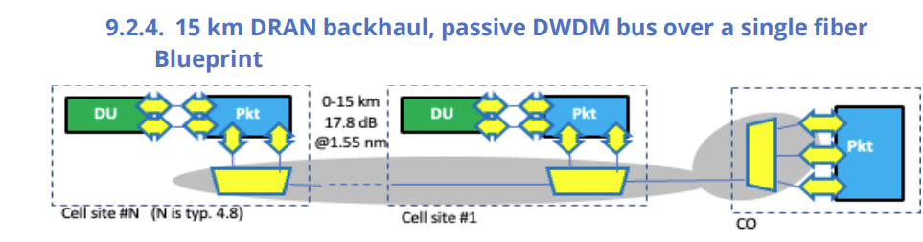
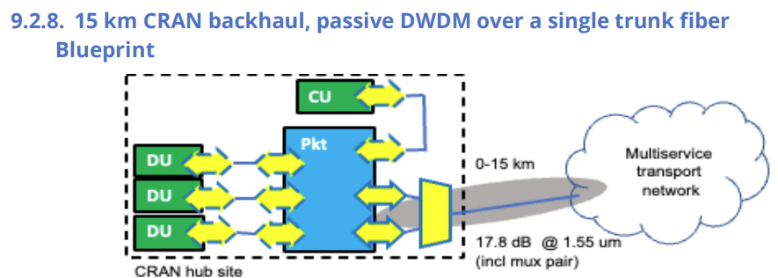
Coherent Optics in RAN and Relevant MOPA Blueprints
Metro, long-haul and DCI are coherent optics application domains, as reflected by current standards
  IEEE Std. 802.3-2022 100GBASE-ZR DWDM, 80 km
  OIF 400ZR, 80 km
  OpenROADM 100G/200G/400G, 500/600 km
  ITU-T G.698.2 100G, 120 km and 500 km
  CableLabs 100G and 200G, 80 km
Today, use of coherent optics in RAN is rare
  100G needed in 1-2 years, 400G in 3-4 years
  Need for lower cost, lower power consumption and smaller form factor
Coherent optics would be a “natural” way to upgrade capacity and distance of relevant DWDM MOPA blueprints
  40 km distance would cover all practical use cases
MOPA identified this as a standardization gap

Slide 3
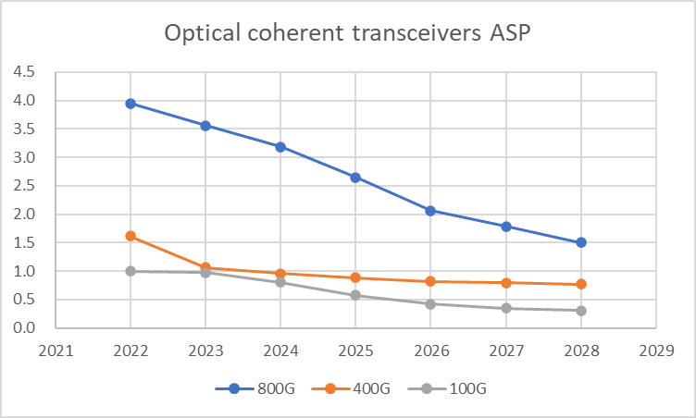
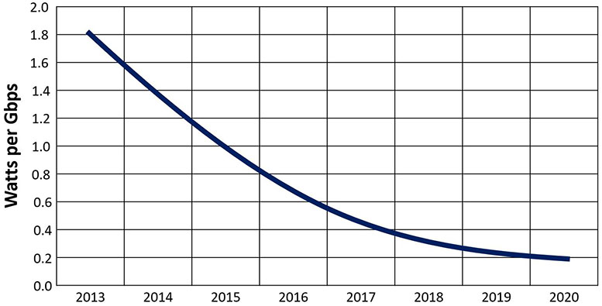
Cost and Power Consumption Trends
Cost and power consumption of coherent optics are both decreasing: will it be sufficient for RANs?
Indirect cost and energy efficiency benefits will come from the longer transmission distance, enabling network centralization and virtualization.
Significant technological innovation (e.g., a “lighter” DSP) is still needed.
Source: Infinera, Five Considerations for Comparing Optical Power Consumption, April 21, 2020

Slide 4
Bi-Directional DWDM Trunk Links
In IM-DD transceivers, the Rx is broadband, allowing Tx and Rx to operate at different channels
DWDM Mux/De-mux combine upstream and downstream wavelengths on single trunk fiber, allowing bi-directional transmission with standard duplex transceivers
In DCO transceivers, the Rx is narrowband (only receives the channel aligned with the wavelength of the LO laser)
Generally, small form factor DCO transceivers share a single laser for Tx and Rx, forcing Tx and Rx to operate on the same channel
Such DCO transceivers can not directly be applied to above link

Slide 5
The Bi-Directional DCO Challenge
λ₁
λ₁
λ₁
Tx
Rx
(a)
Rx
Tx
Option 1: two separate tunable lasers for Tx and local oscillator at Rx
Compatible with both single and double fiber links
No performance penalty
Increases cost by 30%-35%, power consumption by ~20% and requires slightly larger form factor
λ₂
λ₂
λ₂
λ₁
λ₁
λ₁
Tx
Rx
(b)
Rx
Band-split, interleaver or circulator
λ₂
Tx
λ₂
λ₂
1:2 split
λ₁
1:2 split
Tx
Rx
(c)
Option 2: shared tunable laser for Tx and local oscillator at Rx, add circulator for Bi-Di
Smaller impact on cost, no increase in power consumption
Performance impaired due to reflections and potential multi-path interference effects
λ₁
Rx
Tx
λ₁
λ₁
Tx
λ₁
Rx
(d)
Rx
Circulator
λ₁
Tx
λ₁
λ₁

Slide 6
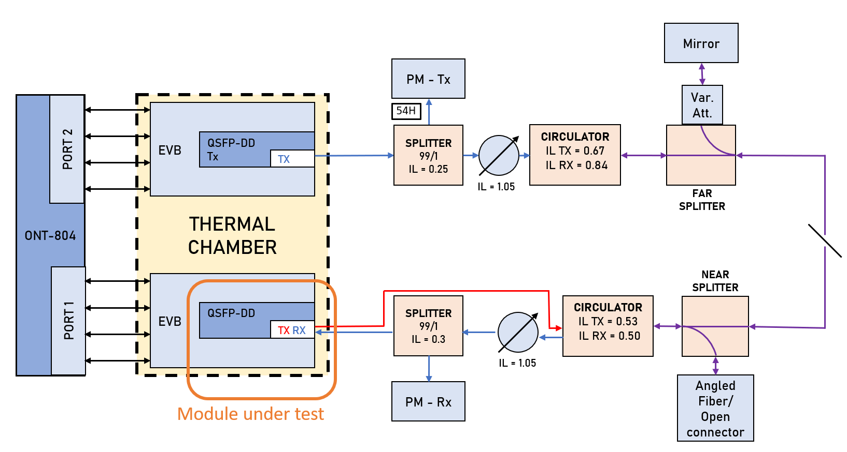
Measurement Setup

Slide 7
Optical Reflection Penalties
Sensitivity penalty vs signal to crosstalk ratio (single reflection)
Two operating modes were tested:
  IEEE Std. 802.3-2022 100GBASE-ZR,
  DP-DQPSK modulation at 28GBd w SC-FEC
  OpenZR+ MSA ZR100-OFEC-QPSK
  DP-QPSK modulation at 30GBd w O-FEC
Chart plots Rx sensitivity penalty vs optical signal to crosstalk ratio (OSXR) due to reflections of Tx signal
With a constant signal to crosstalk ratio, no significant change in penalty was observed by increasing fiber distance or varying return losses of near and far splitters

Slide 8
Application to Existing Blueprint
 | Unit | Tx/Rx A | Circ. |  | Mux |  | Fiber |  | De-mux |  | Circ. | Tx/Rx B
Insertion loss | dB |  | 1.2 |  | 5.5 |  | 6.8 |  | 5.5 |  | 1.2
Return loss | dB |  |  |  | 30.0 |  |  |  | 30.0 |  | 30.0
Directivity | dB |  | 45.0
Signal power A -> B | dBm | -8.0 | → | -9.2 | → | -14.7 | → | -21.5 | → | -27.0 | → | -28.2
 |  | -53.0 | ← |  | ↓ |  |  |  | ↓ |  | ↓
 |  | -40.4 | ← | -39.2 | ← |  |  |  | ↓ |  | ↓
 |  | -65.0 | ← | -63.8 | ← | -58.3 | ← | -51.5 | ← |  | ↓
 |  | -76.0 | ← | -74.8 | ← | -69.3 | ← | -62.5 | ← | -57.0 | ←
Total crosstalk power B -> A | dBm | -40.2
Signal power B -> A | dBm | -28.2 | ← | -27.0 | ← | -21.5 | ← | -14.7 | ← | -9.2 | ← | -8.0
Rx signal power close to back-to-back Rx sensitivity, leaving little margin for reflection penalties
Optical signal to crosstalk ratio less than 12 dB, would result in significant sensitivity penalty (> 2 dB)

Slide 9
Conclusions
Preliminary test results were presented on the use of optical circulators to enable bidirectional transmission with single laser DCO transceivers.
BiDi DCO transceivers with circulator can be considered for use cases similar to existing MOPA blueprints. However, further analysis is required to determine a reasonable trade-off between requirements for various components to avoid excessive penalties due to reflections.
Dual laser DCO transceivers avoid any impairments due to reflections, but come with additional cost and power consumption.

Slide 10
Copyright © 2023

Slide 11
Energy Efficiency Benchmark: IM-DD Pluggables for RAN
2.0W-2.5W 20-25 pJ/bit
1x112G
SFP112
100G
2.5W-3.0W 25-30 pJ/bit
15.6 Gb/s/cm³
3.0W-3.5W 30-35 pJ/bit
1.8W 36 pJ/bit
1x50G
SFP56
50G
2.5W 50 pJ/bit
Energy efficiency improves but not fast enough: more power consumption in the same volume
The requirements for outdoor and I-temp operation add further challenges
7.8 Gb/s/cm³
3.0W 60 pJ/bit
1.5W 60 pJ/bit
1x25G
SFP28
25G
1.8W 72 pJ/bit
3.9 Gb/s/cm³
2.5W 100 pJ/bit
2018
2023
2025
BW density (bit rate/volume)
Short reach grey
pJ/bit = mW/Gbps
BiDi – LAN WDM
DWDM

