Slide 1
New fronthaul features towards 6G
Antonio Tartaglia
François Fredericx

Slide 2
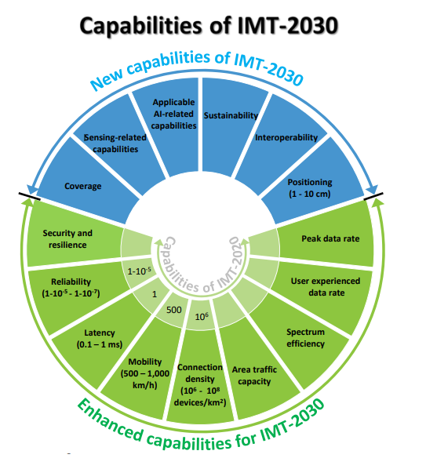
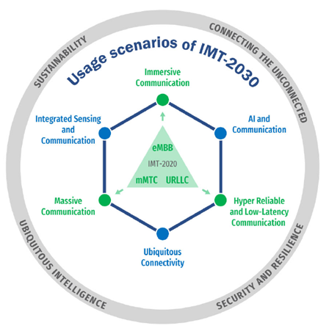
Here we go again
Another “G”, new wheel diagrams, another round of early speculation on how to translate usage scenarios and application requirements into network architectures and enabling technologies
IMT towards 2030 and beyond (itu.int)
Communications in the 6G era - Nokia Bell Labs (bell-labs.com)
6G - Follow the journey to the next generation networks - Ericsson
Notes:
Here we go again: another round of speculation on how the next generation of mobile networks might look like. A new, bigger version of the so-called wheel diagrams detailing usage scenarios and likely requirements for 6G.
Reading these requirements, the feeling we get today is the same of when a customer asks for a solution with zero cost and infinite performance. Well, at least it shouldn’t be ready yesterday, we have time to translate these early scenarios into network architectures and enabling technologies. But the process has just begun.

Slide 3
Some fronthaul predictions “on the brink of 6G”
Traffic increase, higher speed optics, 200G+ electrical lanes
“Silicon for photonics” (ASIC serdes, retimers, DSPs) as important as “silicon photonics”
Challenged link margin at higher speeds , “optical link training” becoming a must
“Coherent lite” coming to challenge IM-DD for shorter and shorter reach (<10km)
Cloud native RAN
Need for deeper centralization, increase of distance (30-40km)
Need for harmonization of RAN optics … and telco-grade servers’ optics !
“Zero touch”: automation and flexibility
Auto-negotiation and self-discovery of bit rates and other capabilities at both endpoints in a link
Unprecedently low and predictable latency
Tighter and tighter sync…
Notes:
But even if the road right now looks twisty and bumpy, at least the general direction is clear:
We will need more capacity, which means higher bit rates, and inevitably will bring our way in RAN the great work being done today on 200G/lane electrical and optical technology.
This means challenges in closing link budgets and an increasing role of both silicon photonics and silicon FOR photonics: asic electrical serdes, retimers, DSPs.
“Optical link training” to optimize performance of the electrical+optical link, avoiding leaving precious margin on the table, will become essential.
Also, “coherent lite” is expected to come to challenge IM-DD inside Radio Access Networks, for the typical Centralized RAN scenarios requiring tens of km of distance.
We will see the rise of Cloud native RAN: there will still be baseband units as we know them today, but they will coexist with virtual baseband units – software running on generic hardware, typically high-end servers in an edge data center.
Cloud RAN will also mean a deeper degree of centralization, with increase of the radius of a CRAN to 30-40km, and will pose the need to harmonize optical solutions between traditional, and virtual baseband units.
As you know, in RAN there is no greenfield and the new solutions will have to coexist and to inter-operate with the legacy ones: the resulting increase of complexity will need to be tamed: “zero touch”, flexibitity and automation, will become even more important than today. For optics, it may mean auto-netogtiation and self-discovery of the bit rates and other capabilities at both ends of a link, something already being discussed for instance in IEEE 802.3dj task force
;ast but not least: if you thought 5G had tough requirements for “tight sync”, accurate timing and synchronization…please take a seat, because 6G is likely making them a lot tougher.

Slide 4
Timing considerations in 6G
“You may delay, but time will not.” Benjamin Franklin
“Time” as in Time delay
Applications like legacy multi-media are happy with tens of ms of delay, but … … advanced applications are born impatient; haptic feedback (~1ms), industry robotics (< 1ms), … Transport latency currently faces the most challenging case: 5G fronthaul in order of 100(‘s) µs No reason that 6G fronthaul will allow us to relax!
“Time” as in Time synchronization
The most demanding ITU 8372.2 class D is not yet defined (but order of multiple ns per T-BC) Again, fronthaul is the most demanding case (Sync Categories, errors between RUs <100ns) And again, 6G will not likely make life easier, on the contrary (thinking about ICAS; 1cm = 33ps!) Note: Science (like in particle physics kind of science) also needs to go extreme on sync accuracy.
More than ever, timing is crucial
When designing DSP-based solutions, please take a moment to consider the impacts on latency and timing accuracy. Would be great to keep them below tens of µs and resp. hundreds of ps !
Notes:
6G use cases, and in particular the new ones related to ubiquitous AI applications at the edge, are pushing end to end latency requirements in the sub-millisecond range, and radio transport including frontahil will likely not have an easier life.
Speaking about time synchronization accuracy, the most demanding scenario for 5G is represented by the so called Class C described by ITU-T G8372.2, and it’s already tough, 10ns max time error per node . In 6g, especially for use cases where sophisticated coordination features between Rus are needed or the mobile network must be capable to discover users position with GPS accuracy or better…Class D is heading our way. It’s still under definition, but it’s likely it will reduce TE to few ns per node.
Timing is crucial, but remember: high bit rate optical solutions and DSPs, if not given the right design targets for that, can pose a serious threat for both low latency and low time synchronization error, as described in the MOPA paper on “tight sync” you can download from our web site. Good ballpark figures to aim for , on the road to 6G: few us of average latency, few hundreds of ps of time synchronization error!

Slide 5



MOPA 3.0 continues to work on these challenges
“Tight sync”
Future-proofing the EEPROM map structure holding typical propagation delay values and their uncertainty, including the foreseeable cases of pluggables with multiple electrical lanes on the host side.
Compensation of typical Tx/Rx propagation delay asymmetries, alone, can greatly reduce the contribution of pluggables to time synchronization error.
“Spreading the word”: proposing the approach to IEEE802.3, SNIA-SFF, ITU-T to facilitate implementation in systems.
“Zero touch”
Remote management of pluggables
Setting the stage to introduce optical link training and auto-negotiation
Testing boundaries: IM-DD vs. coherent WDM
25Gb/s 30-40km IM-DD WDM blueprints for Low Level Split (LLS)
100G coherent WDM, “lite enough” to be used in RAN
“play by the “house rules” : low cost, low power, single fiber operation, deterministic latency…
Is IM-DD WDM really dead at 100G/λ ?
study ongoing to see if there are ways for IM/DD to fight back …
Notes:
We may not have all the details, but the general direction to get to 6G is clear and MOPA is working on all the challenges which lay ahead
We continue to work on “tight sync” –since yesterday, it has become a stand-alone technical paper of the MOPA family, you see there the QR code
We made preparations to face the challenges of high bit rates pluggables: multiple electrical lanes on the host side and internal complex digital parts.
We think compensation of Tx and Rx typical propagation delays at system levell, alone, can provide a leap in improvement of time synchronization accuracy.
We have done a lot of work in the “zero touch” area with remote management of pluggables –as you know, a stand alone technical paper since may 2023 , and we have started to discuss optical link training and autonegotiation.
And of course we are continuing to explore the high capacity solutions pace, with longer reach 25G per wavelength WDM solutions and 100G coherent lite for mobile networks – also a stand alone paper published yesterday. Even if we haven’t completely abandon all hopes to identify some good IM-DD solution at 100G per wavelength, we have an ongoing study item, stay tuned for that!
But as I said, fine print details are a different story. One above all: which form factor will we use in the 200G era ?

Slide 6
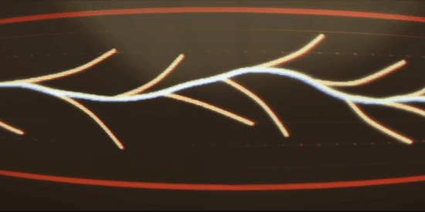
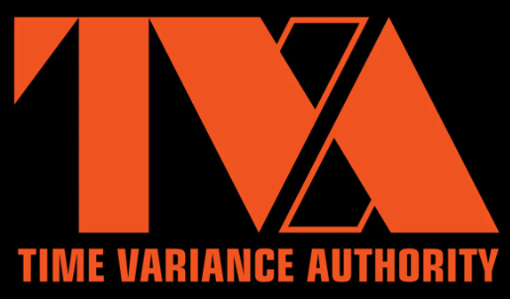
But when it goes to the “next form factor”…
the timeline branches out!
SFPx
NPO
SFPx LPO
CPO
QSFPx
Notes:
And here let me quote my favourite TV show ever…. Loki.
Looking into the future for form factors for 200G, I see the timeline branching into several alternate realities!

Slide 7

Alternate reality #1
Long live the old re-timed pluggable!
More DSP to fight bandwidth limitations of O/E components and electrical links
Power scaling trends of DSPs ?
Remember: they need to be designed with “tight sync” in mind!
SFP224: size unchanged, systems usually can cool SFPx pluggables up to ~3W
Which blueprint categories will be really feasible in less than 3W?
In increasing level of challenge: short reach? BiDi ? xWDM ? Even “coherent lite”?
A sub-variant! Will we quit SFPx and use QSFPx in RAN nodes instead ?
even for single electrical/single optical lane, just to make thermal design possible ?
5W is more forgiving than 3W
will we accept to design slightly less dense nodes?
Notes:
Old Loki = Google

Slide 8

Alternate reality #2
The rise of the linear pluggables
DSPs out of the pluggable modules
No DSP, no tight sync headaches!
ASIC serdes must do the (optical+electrical) link equalization heavy lifting
SFP224: much easier to meet the ~3W limit
Which blueprint categories will be really feasible in less than 3W?
Considering ASIC electrical serdes standardization trends
Ecosystems creation ? Server optics going LPO would boost its appeal…
Careful with optical impairments, they now are on the shoulders of the ASIC serdes…
Will we ever get something more complex than short reach (<2km) SFP224 LPO ?
If all we can get is short reach SFP224 LPO, how will we build a CRAN ?
packet switched blueprints coming to the rescue!
the rise of packet fronthaul: transport nodes hosting longer reach and fiber efficient optics
Notes:
President Loki would probably be Arista

Slide 9

Alternate reality #3
The rise of CPO/NPO
DSPs out of the pluggable modules
No DSP, no tight sync headaches!
Short electrical links, ASIC serdes designers can relax a bit
…but not too much: optical impairments always end up on the ASIC shoulders!
chance to remove optics from the thermal design critical path
Hosts need to pick ONE (short reach) blueprint and live with it.
Pluggability is very hard to give away
It could become a little easier if 200G pluggables could only support <2km optics, anyway
How will we build a CRAN ?
Packet switched blueprints coming to the rescue!
The rise of packet fronthaul: transport nodes hosting longer reach and fiber efficient optics
Notes:
Crocodile Loki: the oddest variant that can unexpectedly save the day for RAN.

Slide 10
Conclusions
Detailed requirements for 6G are in the making, only the general direction is clear
MOPA is already working on topics in that general direction
tight sync
longer reach and higher capacity optical blueprints
“zero touch” : bit rate auto-negotiation and auto-discovery of characteristics of optical links
MOPA plans to explore all the “alternative timelines”
including the ones we can barely glimpse
what if liquid cooling comes of age for RAN ?
what if “over the air” sync comes of age and “tight sync” requirements become less scary ?
what if Analogue Radio-over-Fiber is in for a comeback ?
…………………
Second season of the show: all the “alternative timelines” may be reconciled !
different application scenario, different requirements 🡪 different solutions

Slide 11
Copyright © 2022xxxx

